Slide 1

Net4j Signalling Platform
2.0 Release Review
(Mini Deck)
Eike Stepper
stepper@esc-net.de
http://www.esc-net.de
http://thegordian.blogspot.com
Berlin, Germany
Planned Review Date:
Project Newsgroup:
June 10th, 2009
eclipse.tools.emf

Slide 2
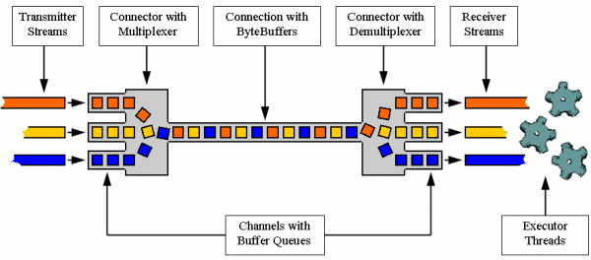
Introduction
The Net4j Signalling platform is an extensible client/server communications framework. Net4j eases the development of fast and maintainable application protocols that are independent of the physical transport medium. Transport protocols are pluggable and Net4j ships with support for TCP, HTTP and in-memory transport. The core of Net4j is a fast, asynchronous and non-blocking buffer multiplexing kernel, based on OSGi but also executable stand-alone.
Project URL:
http://wiki.eclipse.org/Net4j

Slide 3
Release Highlights
Quality of APIs
  2.0 API is partly incompatible with 1.0
  API Toling has been used consequently
End of Life
  None
IP
  IP Log URL: http://www.eclipse.org/modeling/emf/net4j/project-info/eclipse-project-ip-log.csv
  No issues
Committer Diversity
  7 committers from 7 different companies
  Several additions to the team are pending

Slide 4
Project Activity Since 1.0
Bugzilla
  28 of 42 enhancements done (10 left open)
  13 of 20 bugs fixed (4 left open)
CVS
  44187 changed lines of code committed (incl. CDO)
Communication
  More than 120 newsgroup posts
  Talk at EclipseCon, several demo camps
  Several magazine articles

